Slide 1





Lesson 4:
Ghostbuster

Slide 2
Slide

Slide 3
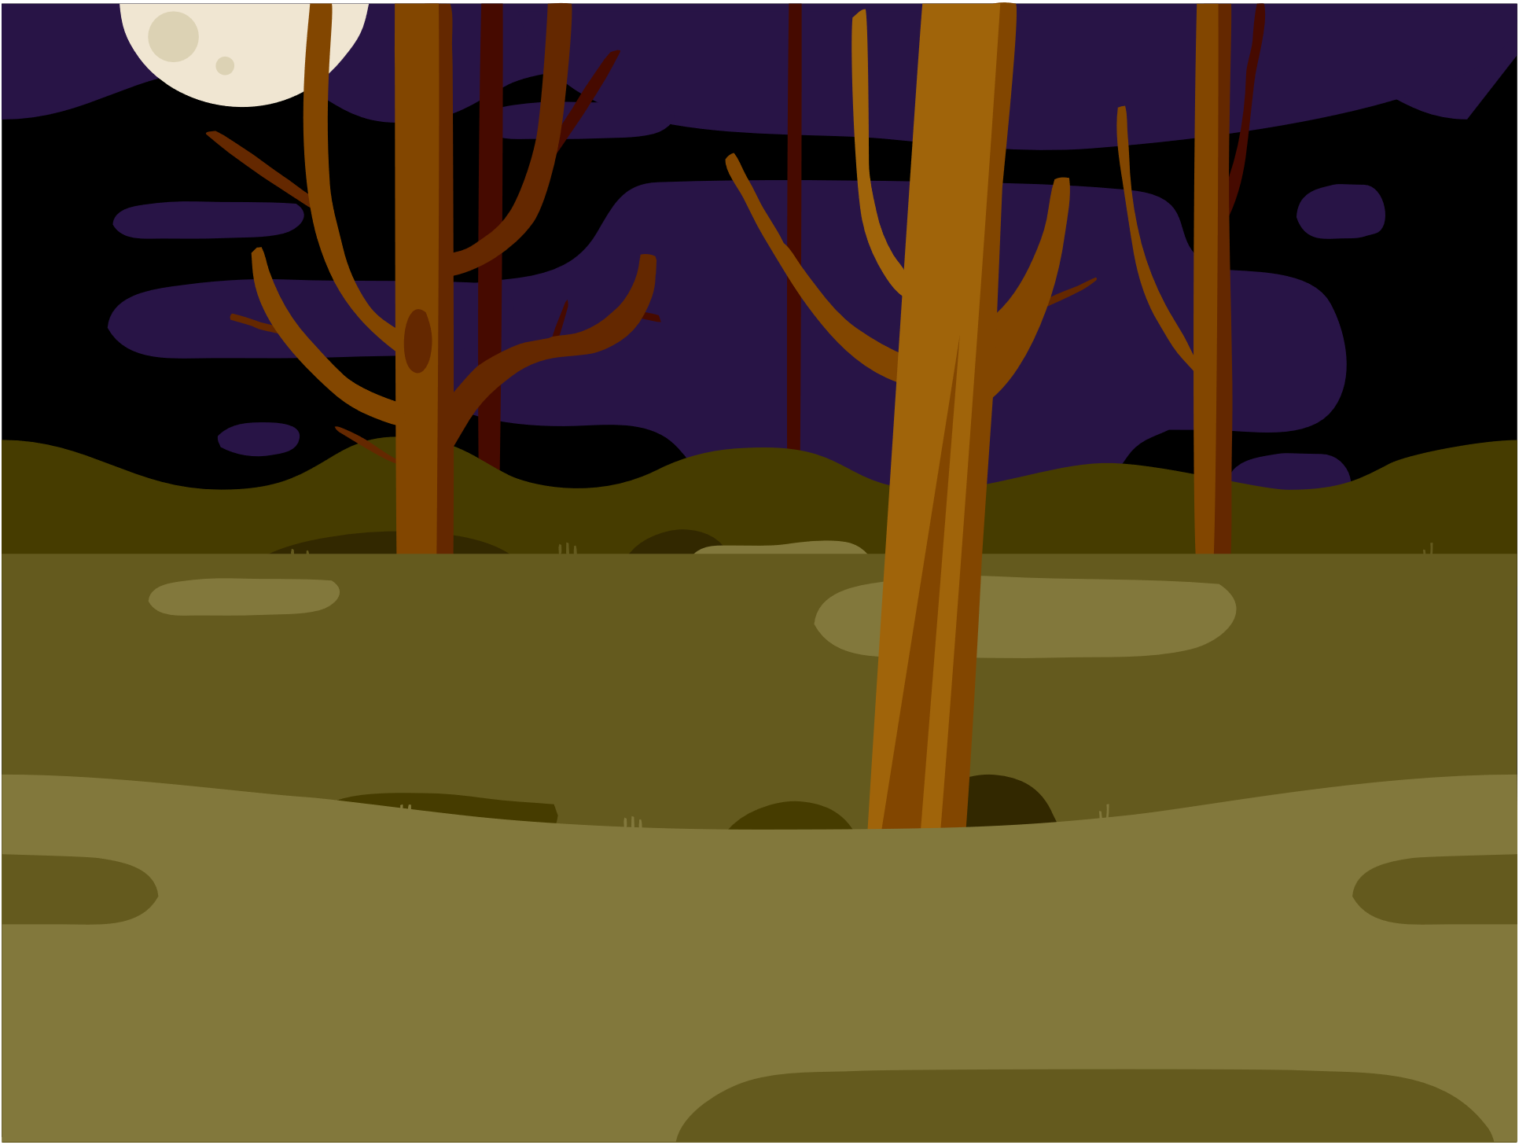
Backdrop - Woods

Slide 4


Sprites
Ghost
Magicwand

Slide 5

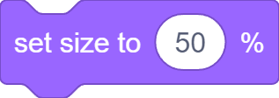
Change Ghost Size
OR
Manually
Code Block

Slide 6
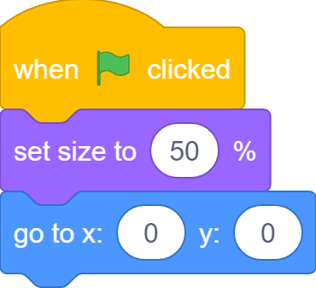
Change Ghost Size
100%
50%

Slide 7


Click to Hide Ghost

Slide 8
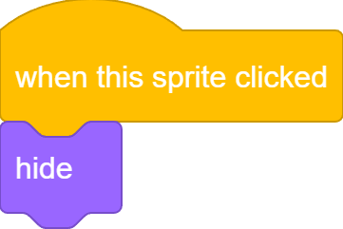

Click to Hide Ghost

Slide 9
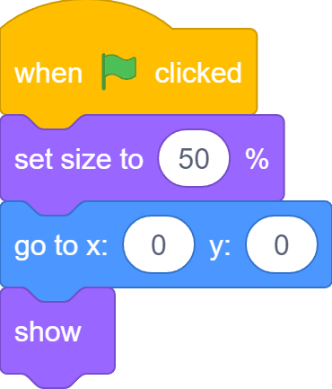
Click to Hide Ghost
Remember to show too!

Slide 10

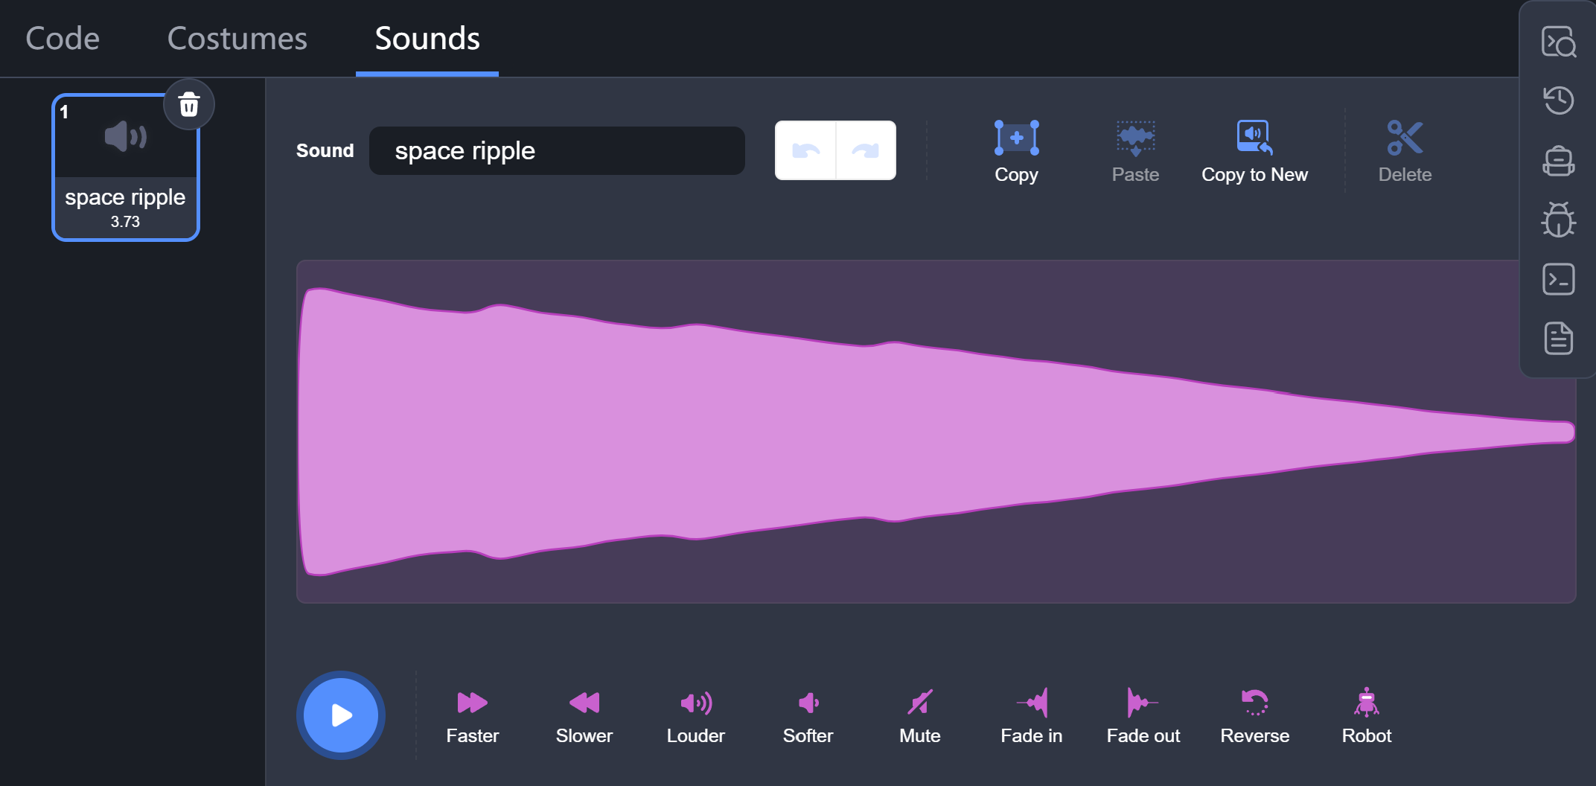
“POP”

Slide 11
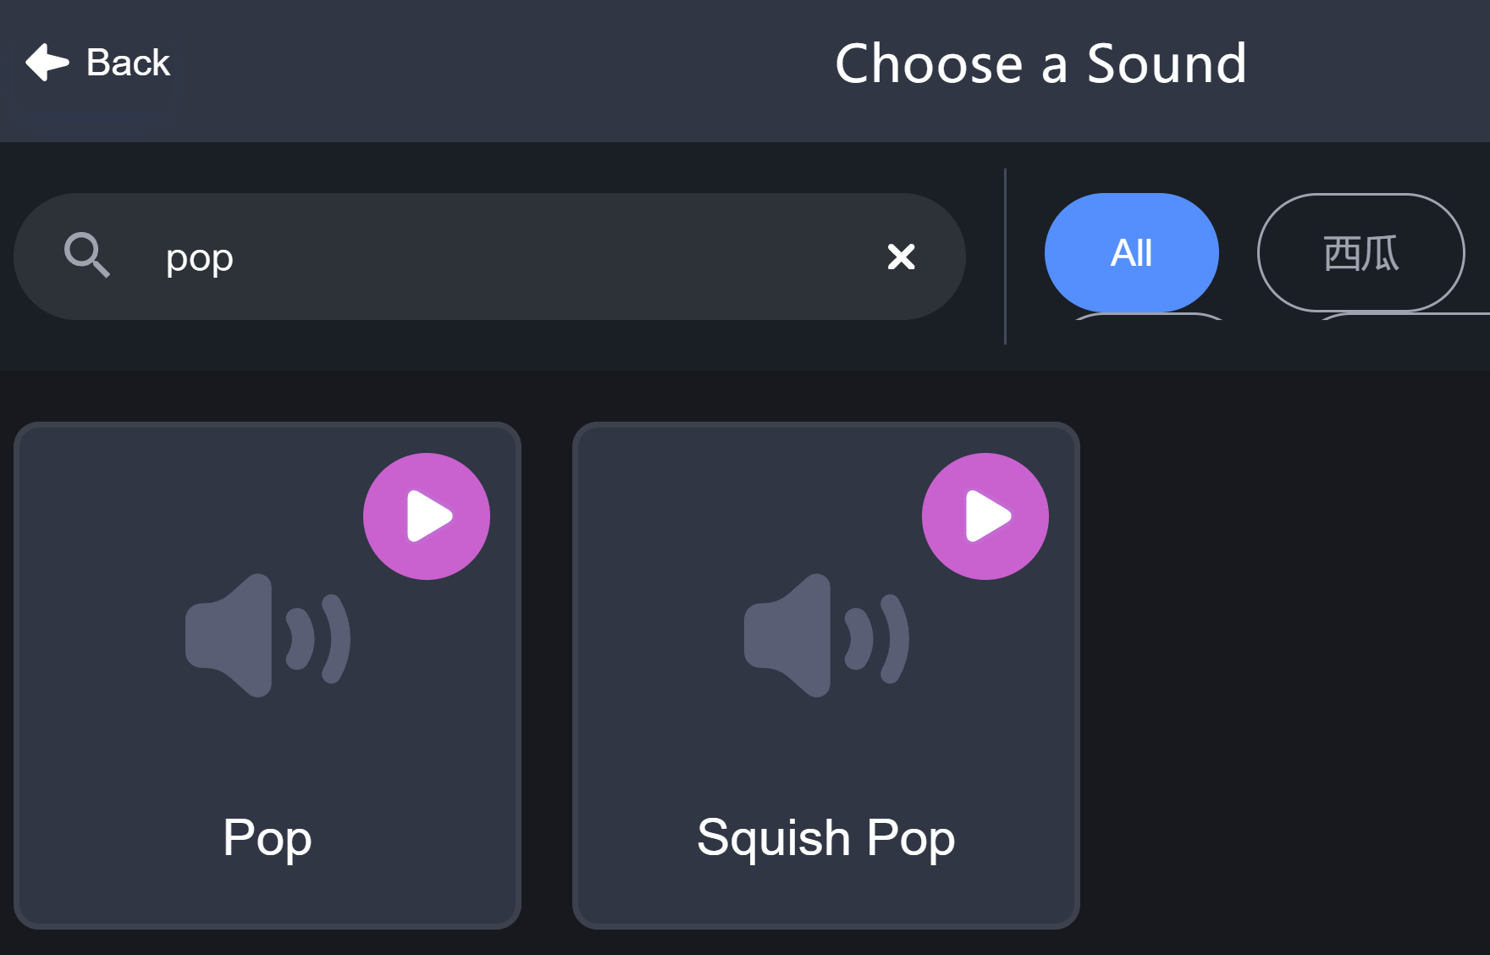
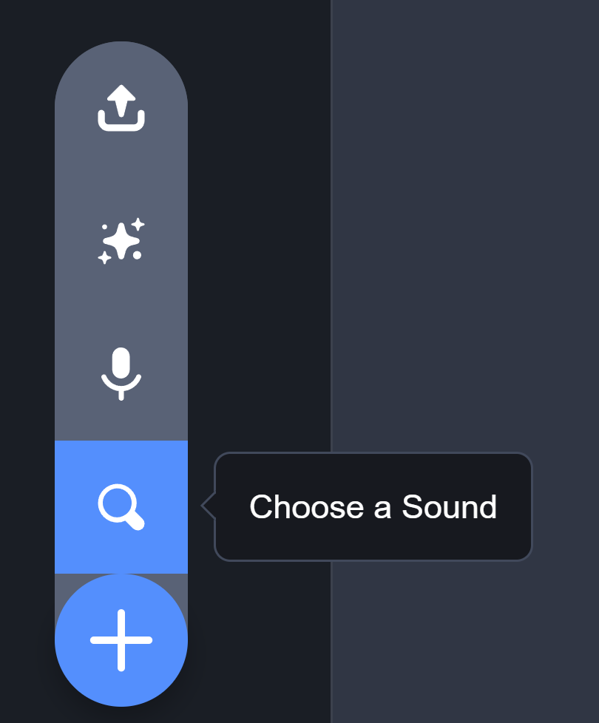
“POP”

Slide 12

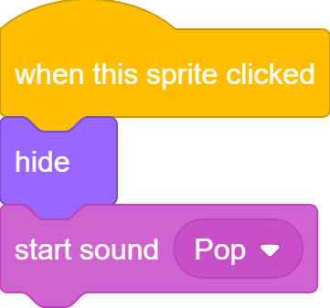
“POP”

Slide 13
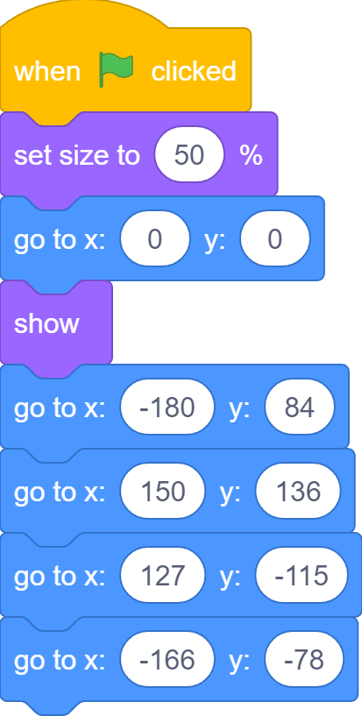
Ghost Wanders Around

Slide 14
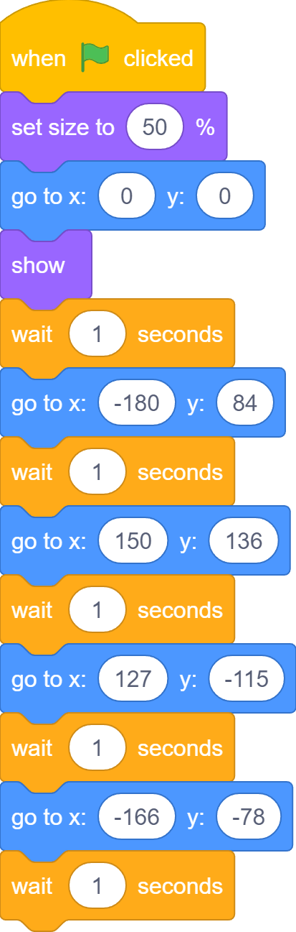
Ghost Wanders Around
TOO fast!
Let’s wait!

Slide 15
Ghost Wanders Around
Anytime we click, the ghost is hidden forever from that point on!

Slide 16
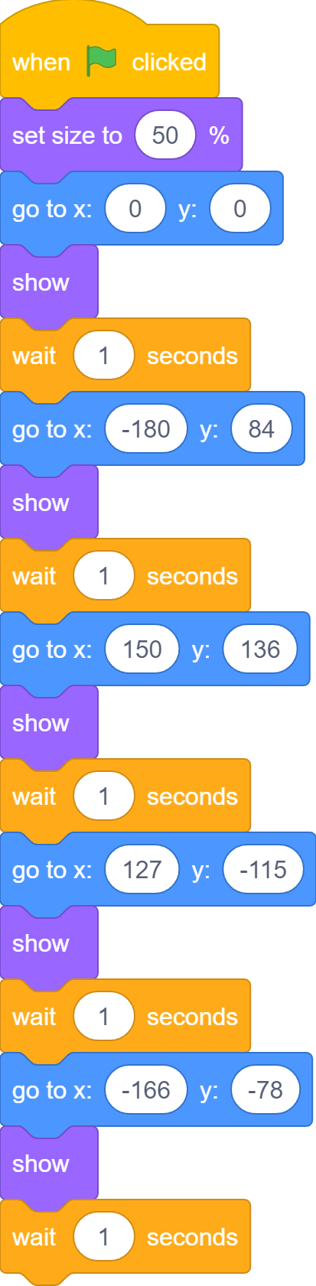
Ghost Wanders Around
Let’s show after each new position!

Slide 17
But This is Boring…
First time we play…
Second time we play…
Third time we play…
Always the same locations, BORING!!!

Slide 18

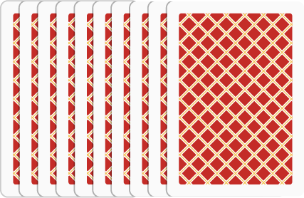
Random is a Surprise

Slide 19

Go to Random Position

Slide 20
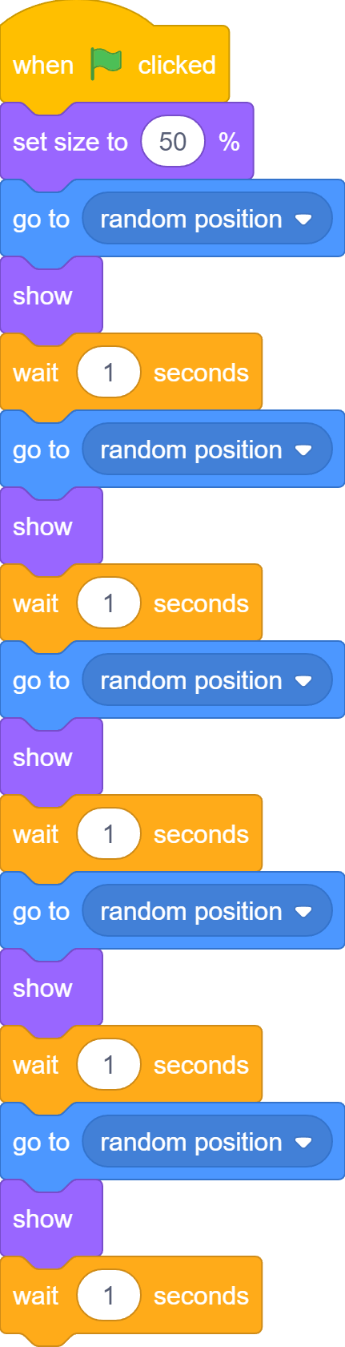
Go to Random Position

Slide 21
This is Exciting!!!
First time we play…
Second time we play…
Third time we play…
Different locations each time!!!

Slide 22
I See Some Repetitions
Go to random position, show up, and wait for 1 second
Go to random position, show up, and wait for 1 second
Go to random position, show up, and wait for 1 second
Go to random position, show up, and wait for 1 second
Go to random position, show up, and wait for 1 second

Slide 23
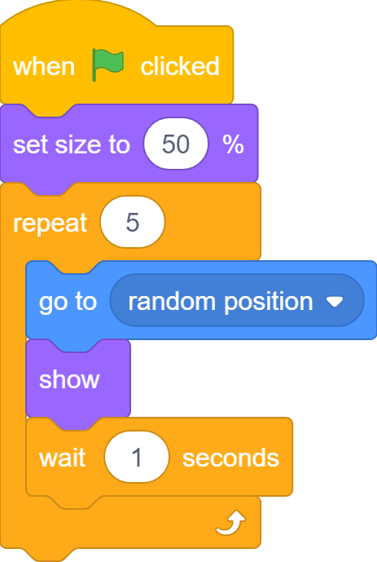
Let’s REPEAT!

Slide 24
Let’s REPEAT!
Change this iteration number and you can repeat 100 times, 1000 times or as many as you like!

Slide 25
End of loop, End of Game
After all iterations, the loop completes and the game comes to an end.
End of loop, end of game.

Slide 26

Run Forever
A lot of real games run forever until we decide to stop them.

Slide 27

Forever Loop
Repeatedly run code forever

Slide 28
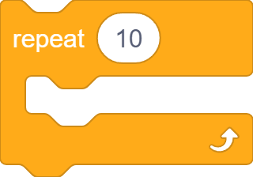
Repeat vs. Forever
Different names
Forever loop does not have iteration numbers

Slide 29



Repeat vs. Forever
Add other blocks at the end?

Slide 30
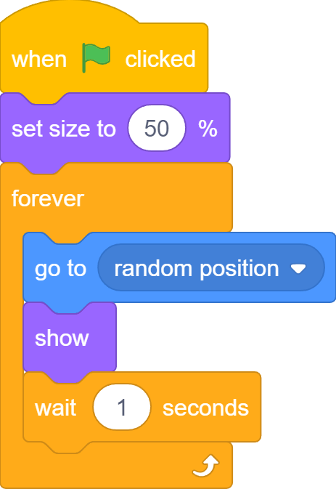
Ghost Wanders Forever

Slide 31
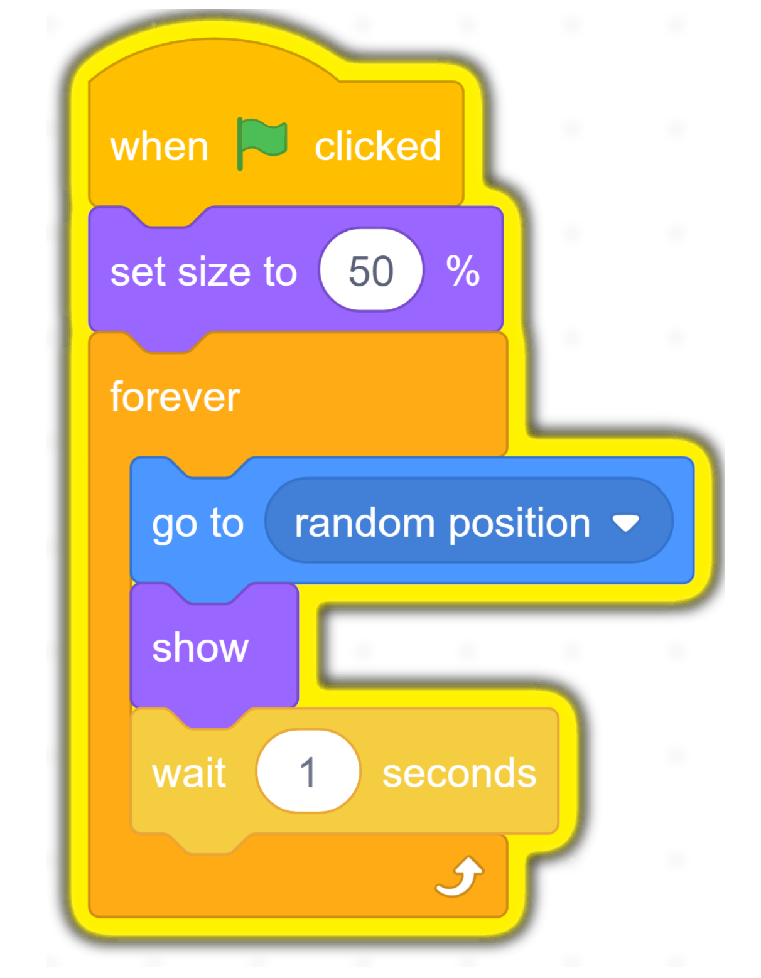



Start, Pause and Stop

Slide 32
Recap
We often use forever loop to keep programs running forever. Programs should only stop when players choose to do so.

Slide 33
More Randomness?
Always wait for one second, BORING! Can add some randomness?

Slide 34
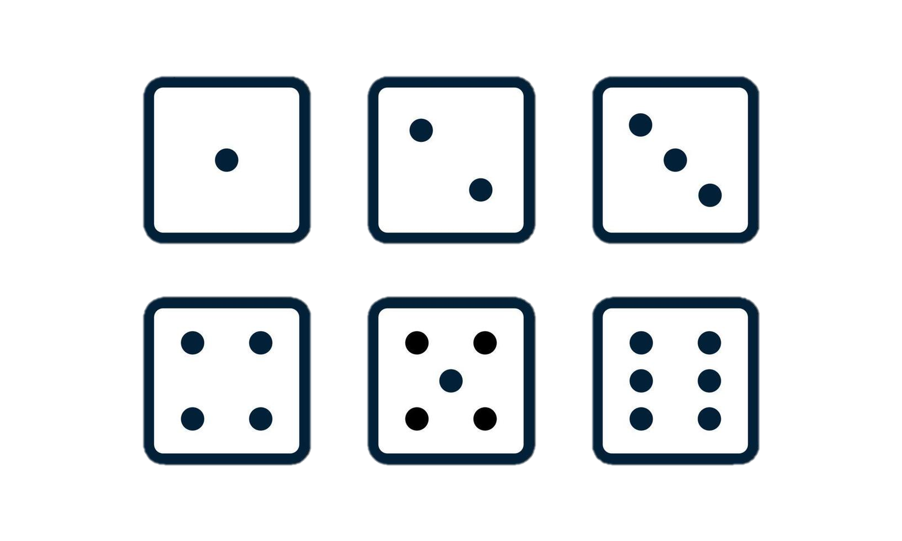
Rolling a Dice
Result is a random number from 1 to 6.

Slide 35
Pick a Random Number
Can we pick a random number between any range in Scratch?

Slide 36

Pick a Random Number
1 2 3 4 5 6 7 8 9 10
A random number between 1 and 10

Slide 37


Wait randomly
Rectangle block with rounded corners can be put inside rectangle slots with rounded corners

Slide 38
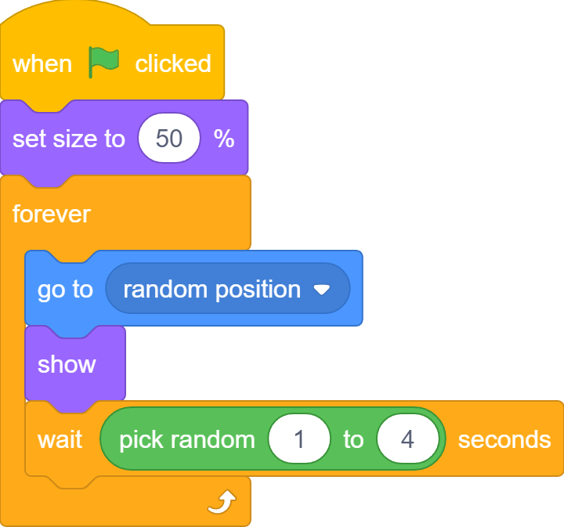
Wait randomly

Slide 39
What we learnt…
How to show and hide a sprite…

Slide 40
Exercises
Can you find more “loop” examples in real life?
What would happen if you repeat 0 times? A negative number of times?
Can you make a sprite rotate like the second hand of a clock, meaning it ticks each second, and finishes one full circle after 60 seconds?
Add more sprites to catch the bus!

Slide 41
Thank you and see you in the next lesson!

